Slide 1
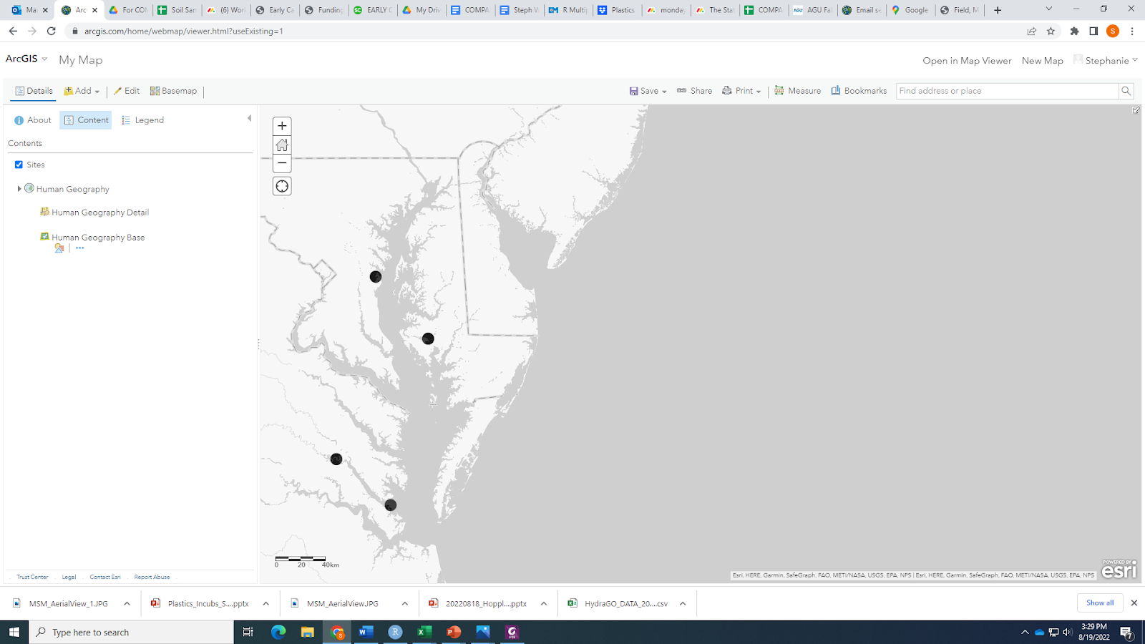
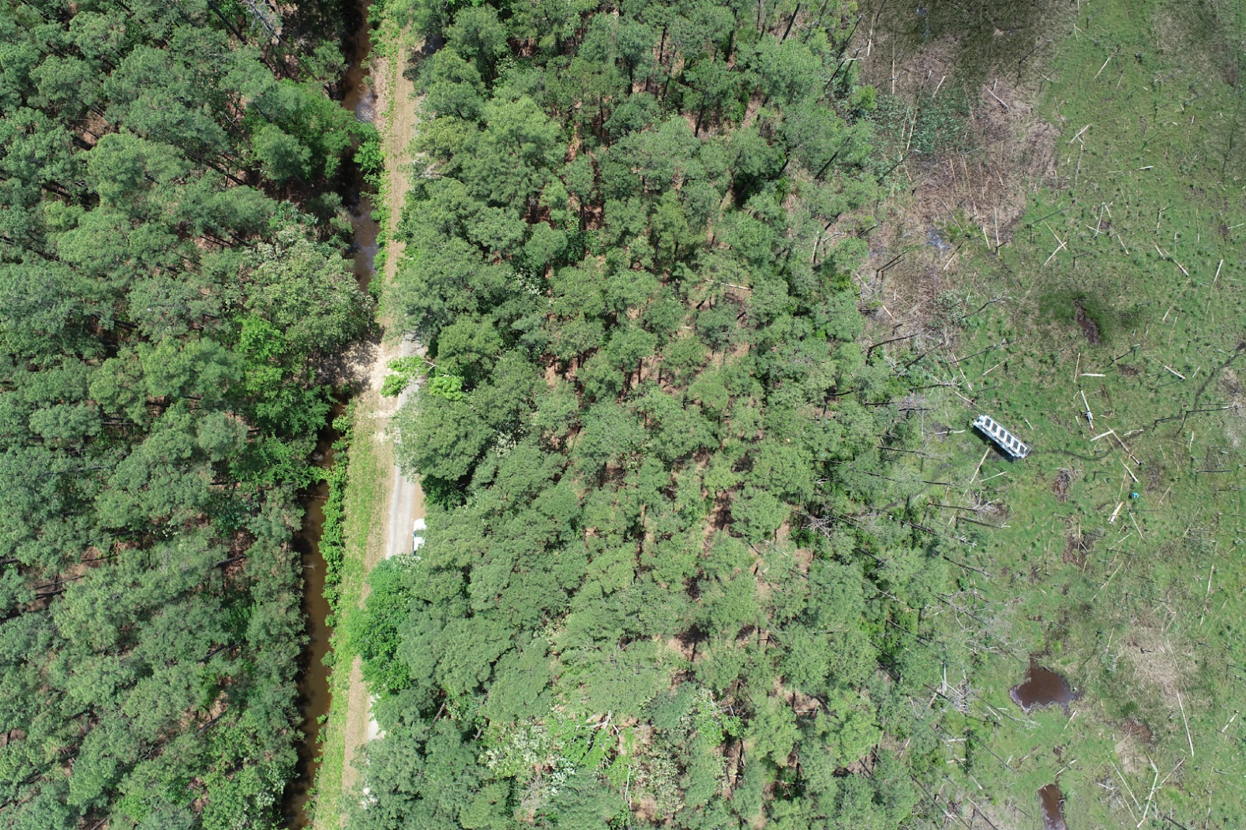
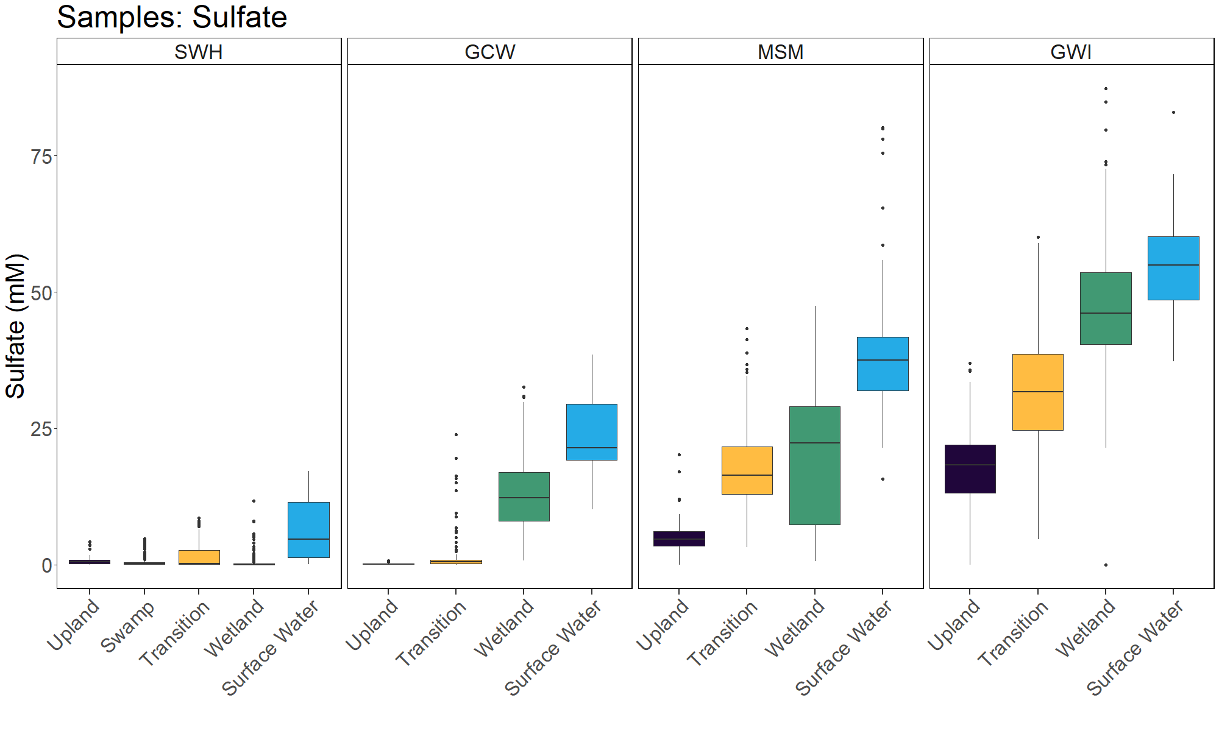
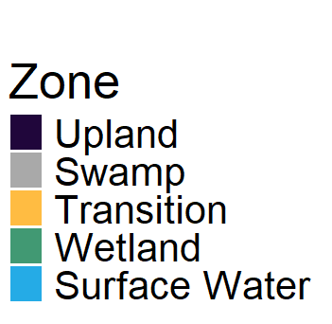
Porewater sulfate varies across the coastal terrestrial-aquatic interface, sampling depths, and seasonally
Zoe Read, Smithsonian Environmental Research Center, Maryland, USA
Background
We monitor transects including upland coastal forest, forest transitioning to wetland, and wetlands in the Chesapeake Bay Region at four sites that are oligohaline, mesohaline, and polyhaline
Porewater sampling from 2022-2025
Analyzed for DIC, DOC, Total Alkalinity, CDOM, H₂S, Cl⁻, Nutrients, and SO₄²⁻
Site | Salinity
Sweethall | 0-2
GCReW | 8-10
MoneyStump | 8-10
Goodwin Islands | 18-20
GCReW
Money Stump
Sweethall
Goodwin Islands
Upland
Transition
Wetland
Porewater Sulfate
Porewater was analyzed for SO₄²⁻ in 2,293 samples
Sulfate increased from upland forest through transition zones to the wetland
Sulfate also increased from Sweethall site (oligohaline) to Goodwin Islands site (polyhaline).
Surface water was a source of sulfate into these ecosystems.
File Name // File Date // PNNL-SA-#####
Notes:
• Contact Digital Duplicating (375-2969, http://digitalduplicating.pnl.gov) to order poster printing and finishing services for your completed poster design.
• Remember to have your poster cleared for public display/distribution through the ERICA Information Release system (http://erica.pnl.gov).

